Slide 1
ONLINE SHOP

Slide 2
PROBLEM STATEMENT
Create a website using FullStack Technologies for a furniture designing company. The website will serve the purpose of introducing the company to the user and will also display the products done by the company. It is completely responsive website.

Slide 3
INTRODUCTION
The project objective is to deliver the information about the existing shop.
This project is an attempt to provide the advantages of online shopping to customers of a real shop.
Create a website for furniture design company.
Provide an online platform for displaying the products.

Slide 4
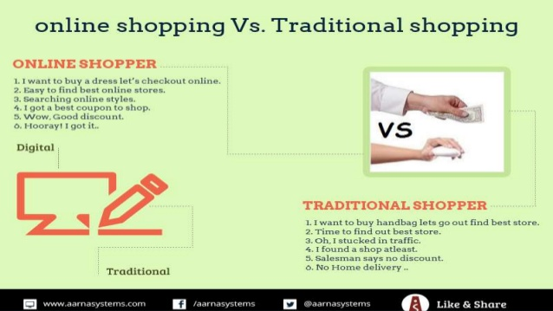

Slide 5
FEASIBILITY STUDY
Technical Feasibility: We can say that our Application would be technically feasible because we are not getting any difficulty related to the resource of development and maintenance of the project. It is easy to use by all.
Economically Feasibility: The​ project that we are building would be economical as it wouldn’t be taking any extra tools other than required tools for development and is available for free. We have made sure that neither user nor the developer need to spend any money for the accessing and development of the system. Everything will be done using Open Source tools available.
Schedule Feasibility: It is defined as the state of being probable and will be completed within the scheduled time. We are working from day one on the project.

Slide 6
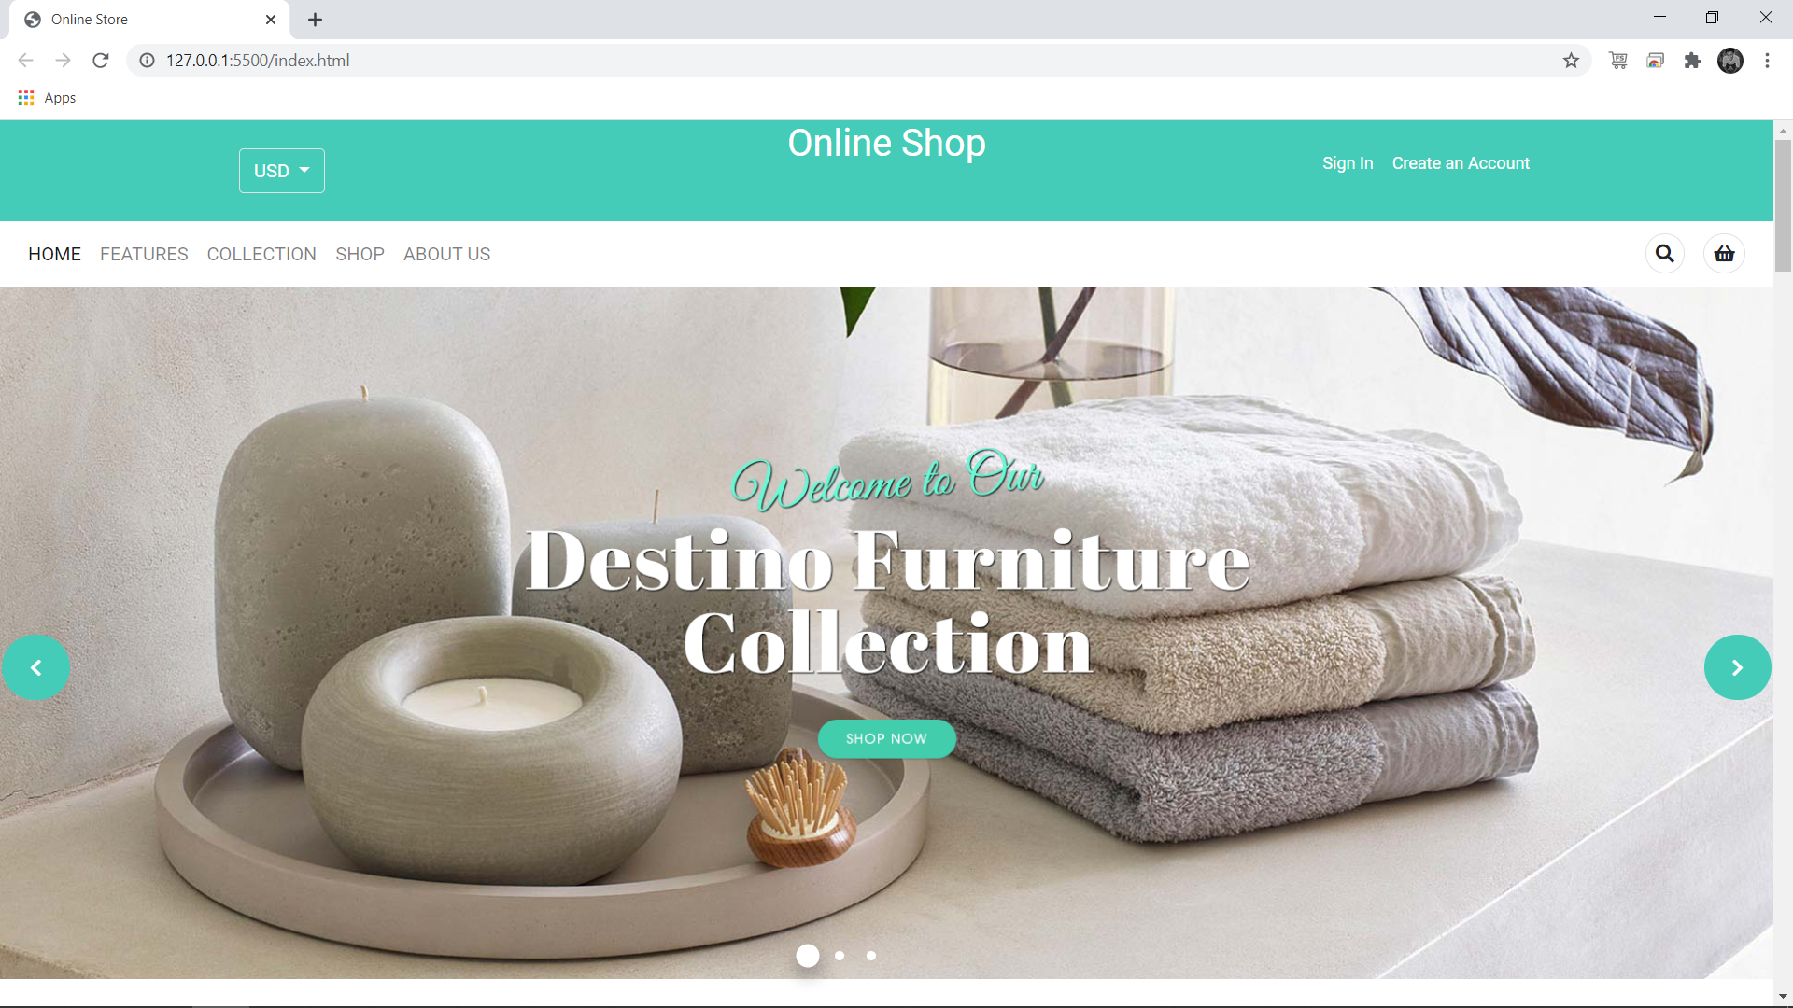
PROJECT TITLE

Slide 7
PROJECT TITLE
NAVIGATION BAR

Slide 8
HOME SLIDER

Slide 9


Slide 10
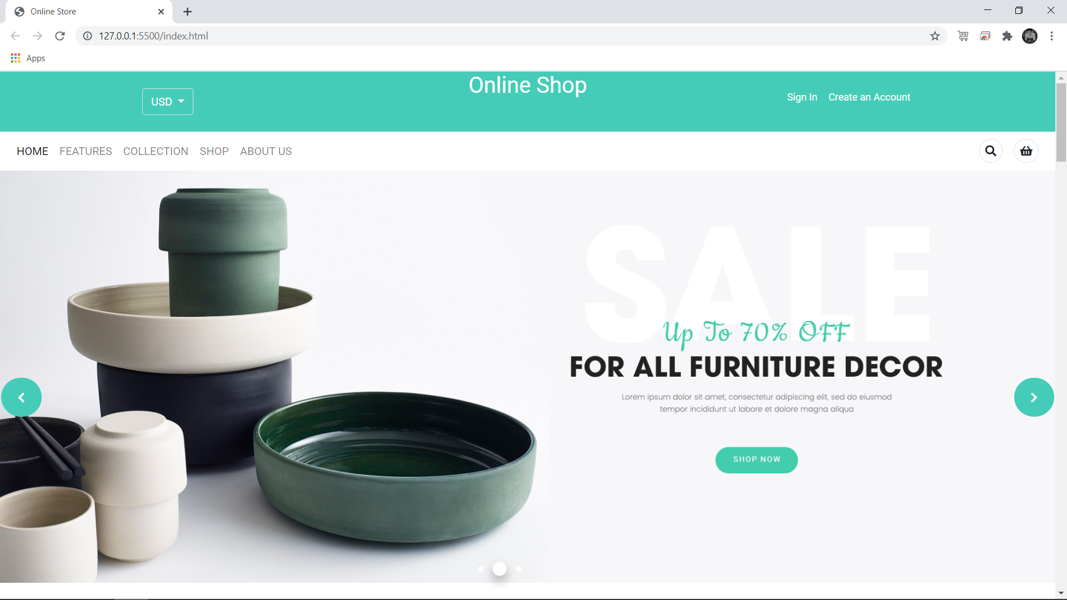

Slide 11
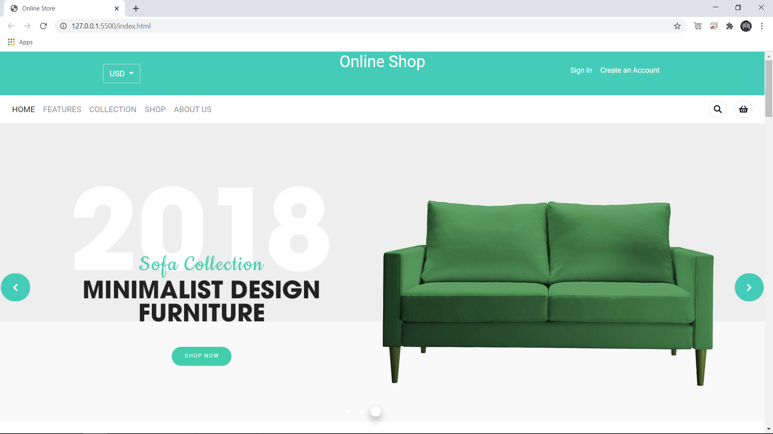

Slide 12
FUTURE SCOPE

Slide 13
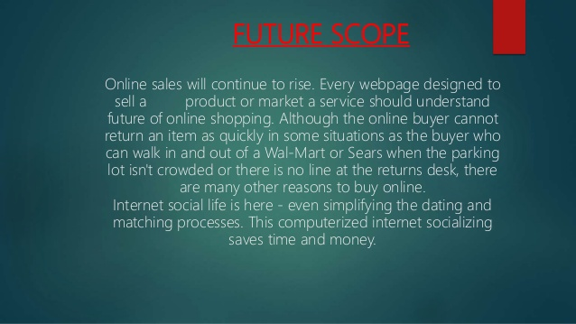

Slide 14
PROS
A new user who is looking for some good stuff in furniture for the building to give a new look should know about the company through the homepage.
Provide a solution to the user for contacting the company in case they want the work to be done with minimal discomfort.
Comparison is easy.
No queue to wait.

Slide 15
What contribution does the project make and where?
Having an online website would raise awareness about the Furniture Designing Company, people could browse the website to get the information about various services the company provides, people could see the new products launched and can get the contact details if they have any query about our product/services.
Since having a website for brand awareness, it would eventually increase the company sales and also will make sure of the competitive price offered, which would help customers to make a better purchase decision.

Slide 16
CONCLUSION
Every Individual/Company doing business should have an online presence on the Internet.

Slide 17
THANK YOU

